Slide 1
RISCBOT: Mobile Robots Exploration And Mapping In 2D
Sithisone Kalaya, Hussain A. Alhazmi, Advisor: Prof. Tarek Sobh
Robotics, Intelligent Sensing & Control (RISC) Lab.
School of Engineering, University of Bridgeport.

Slide 2
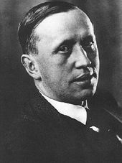
INTRODUCTION
‘Robot’
1920 satirical play called RUR (Rossum's Universal Robots)
Czech word, ‘Robota’, (pronounced "chop'ek"), meaning compulsory labor or slave
The plot was simple: A man makes a robot, then the robot kills the man!
Karel Čapek

Slide 3
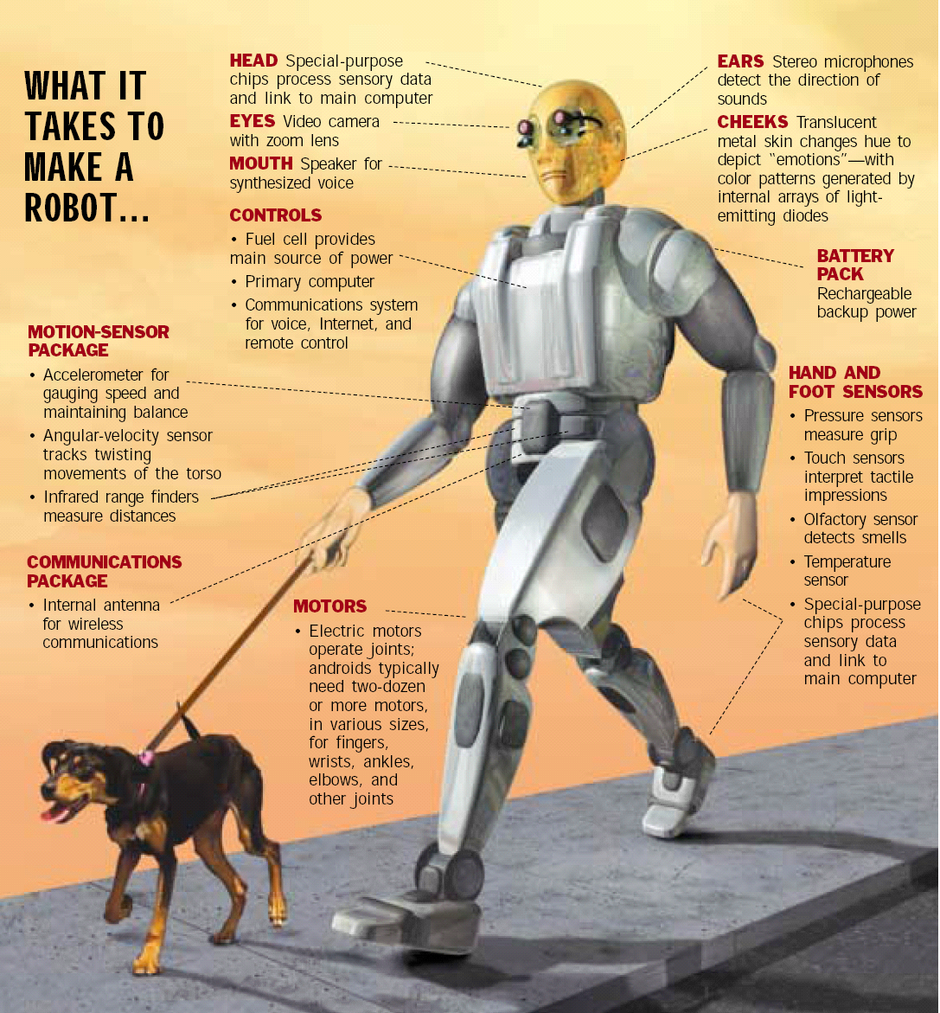
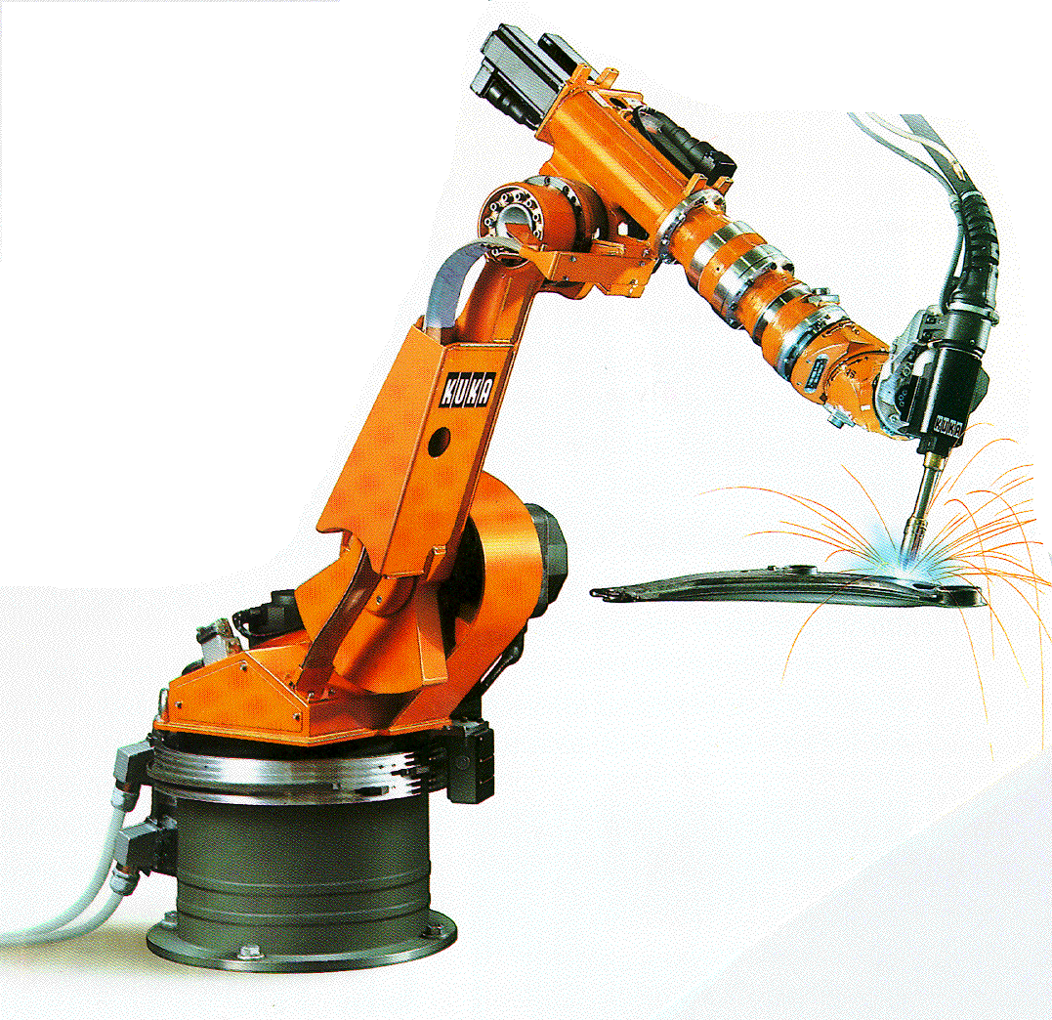
Robot – According to The Robot Institute of America (1979) a robot is “a reprogrammable, multifunctional manipulator designed to move materials, parts, tools, or specialized devices through various programmed motions for the performance of a variety of tasks."
Robotics – The science dealing with the design, construction and operation of robots

Slide 4
Inspirations from a course in Robotics
Transformations
Inverse kinematics
Trajectory generation
Jacobians
Kinematics
Robot control

Slide 5
Ideas and Motivation
Build small mobile robots to work with a host computer.
They must be able to:
Explore any unknown environment
Avoiding object
Communication with a host computer
Gathering information in its environment
Build a map from data collected.

Slide 6
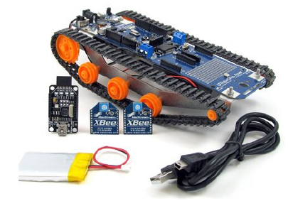
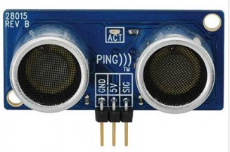
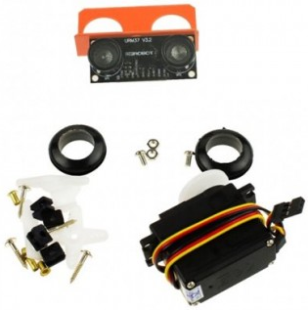
Building the Mobile Robots
We constructed two mobile base on DFRobotShop Rover V2-Arduino.
The robot was fitted with an Ultrasonic Range Finders.
Bluetooth/XBee communication device
We used ARDUINO API software to control the robot.

Slide 7
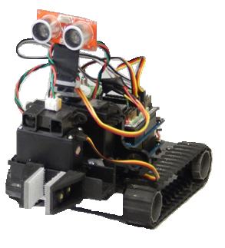
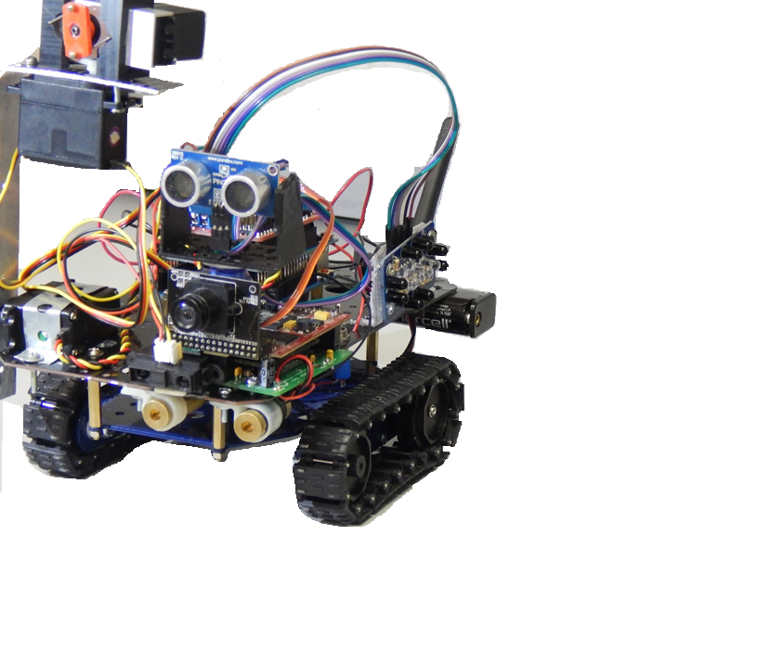
Our Mobile Robots

Slide 8
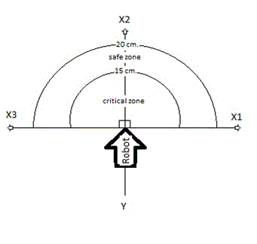
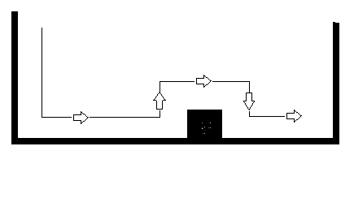
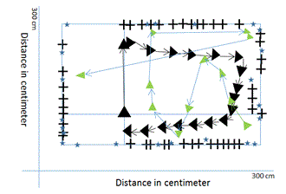
METHODOLOGY
The system consist of three main functionalities:
Navigation such as obstacle avoidance and boundary tracing.
Communication and data transmission.
Map construction.
Obstacle avoidance
Robot can see Through an Ultrasonic sensor
Constructed a map
Communication with a host PC

Slide 9
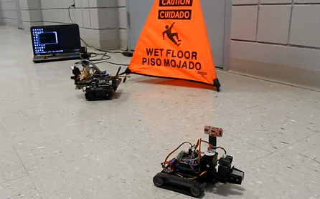
IMPELEMENTATION

Slide 10
FUTURE WORK
Future additional enhancements to maximize their capabilities includes implementing EKF-SLAM algorithm for real time map. Simultaneous Localization and Mapping (SLAM) , Extended Kalman Filter (EKF)
Web enable to allow multiple users to access data from different locations
Implementing laser scanner for more accurate measurements
Implementing camera for viewing of live video

Slide 11
Thank you Questions/answers

